Slide 1
Module 2 – Healthy Minds and Bodies
ESP3100 – Social and emotional wellbeing in contemporary secondary contexts

Slide 2
Stress
What is it? How would you define stress?
Can stress ever be positive?
When should we be worried about stress?

Slide 3
Stress
“Stress is a natural human response to pressure when faced with challenging situations. That pressure is not only about what’s happening around us, but often also about demands we place on ourselves.”
“Experiencing stress is part of being alive and some stress helps increase our alertness and energy to meet challenging situations.” (Lifeline Australia, 2019)
What are some things that could cause stress?
Group them into ‘good stress’ and ‘bad stress’

Slide 4
Mental Health vs Mental Illness
“The capacities of each of us to feel, think and act in ways that enhance our ability to enjoy life and deal with the challenges we face.” (Public Health Agency of Canada, 2019)
Mental health is simply a term used to describe the state of your mind at any particular time. Just as we talk about physical health as being good, not so good, improving etc, so too can we talk about mental health.
Mental illness, just like a physical illness is a diagnosed condition. Mental illness is not simply “feeling down” or “worried”, mental illness is diagnosed by a health professional based on a combination of symptoms, usually over a period of time.
We will discuss some mental illnesses over the next two weeks, but this week are focusing on mental health

Slide 5
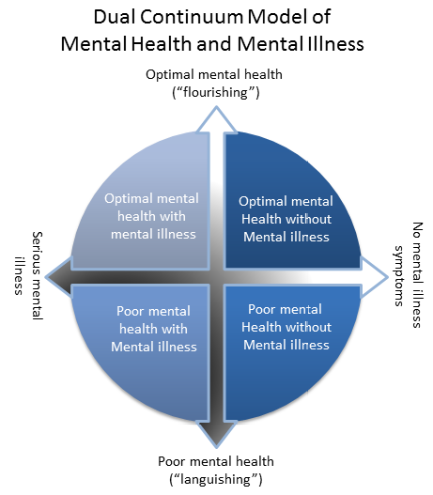
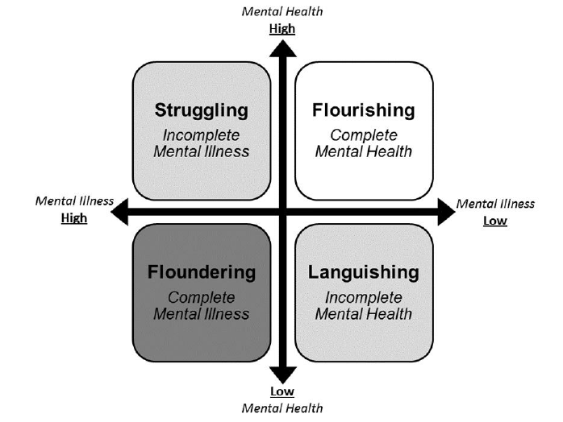
A model of mental health
(Canadian Association of College and University Student Services & Canadian Mental Health Association, 2013)
(Keyes & Lopez, 2002)

Slide 6
Case Study
John is a student in your Year 10 English class. He hasn’t been completing homework lately, which is unlike him and you question him on it. He then tells you that his mother and father have split up last month and it’s been hard for him. He feels he is to blame as he is a pro-snowboarder and believes the financial strain of his sport is what caused the split.
How do you react in this situation?

Slide 7
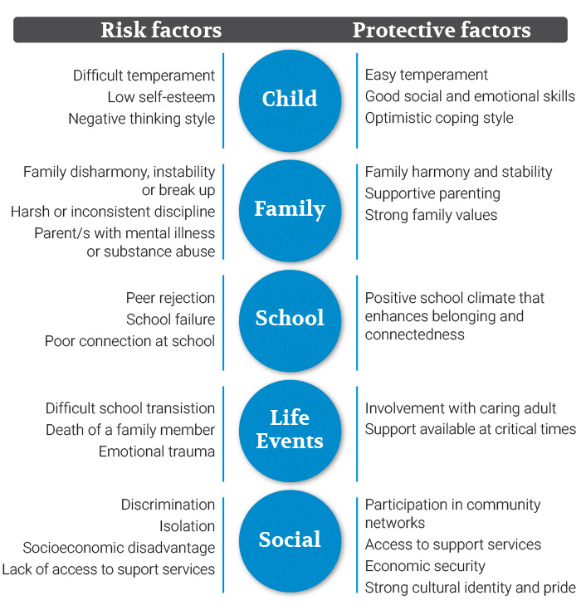
Risk and Protective factors
There are a range of influences and events – both positive and negative – that impact an individual’s mental health. These are known as risk and protective factors

Slide 8
Risk factors
Risk factors increase the likelihood of mental health issues developing during childhood and beyond. These include internal, family or environmental characteristics, and experiences and events that challenge social and emotional wellbeing.
What do you believe some of these risk factors could be?

Slide 9
Risk Factors
Social Environment
Family conflict
Loss of an important person
Events
Death in the family
Loss of home
Home Environment
Harsh or inconsistent parenting
Biological
Low birthweight
Family history of mental illness
Developmental issues
Family financial difficulties
Lack of supervision
Family separation

Slide 10
Protective factors
Protective factors decrease the likelihood of mental health issues and build resilience, even when risk factors are present. Enhancing protective factors means young people are less likely to be vulnerable because they receive the acceptance and support required for learning, social and emotional development and resilience.
What do you believe some of these protective factors could be?

Slide 11
Protective factors
Social Connection
Positive connection between family and teachers
A caring relationship with family and/or educators
Environmental Factors
Family harmony and stability with consistent parenting
Participation in community networks
Internal Factors
Easy-going temperament
Good social and emotional skills
Economic security
Optimistic attitude
Sense of independences
Good communication and social skills
Ability to identify, express and manage emotions

Slide 12
What does a positive learning community look like?
Welcoming
Signage and office areas well presented
Visitors greeted in a friendly manner
Safe
Safety risks carefully considered
Clear policies
Space for students and families to meet and wait
Simple sign-in processes
Teachers are approachable and take initiative to speak with students and families
Breaches taken seriously and addressed
Friendly
What could a positive learning community look like in your classroom? Use the headings of welcoming, friendly and safe to guide your ideas.

Slide 13
Activity
In groups, read about one element that makes up the Australian Student Wellbeing Framework (Education Services Australia, 2017). These include leadership, inclusion, student voice, partnerships and support.
1. Describe the element to the class
2. List how a school can incorporate this element within its culture
3. List ways a teacher can incorporate this element within their classroom

Slide 14
Activity
Read When students are traumatized, teachers are too (Minero, 2017)
Make a list of 3 things you can do to improve your wellbeing

Slide 15
Resources to encourage healthy minds and bodies
Apps to encourage mindfulness:
Stop, Breathe & Think
Smiling Mind
Gratitude
App to encourage sleep:
Recharge – move well, sleep well, be well
App to encourage physical health:
Food switch
That sugar app
Strava
Websites:
https://au.reachout.com/
http://healthy-kids.com.au/kids/high-school-2/
http://www.cyh.com.au/SubContent.aspx?p=490

