Slide 1
Slide 1: Title: Checking the wellbeing
Staff presentation

Slide 2
Aims
In this session, we will:
explore the concept of wellbeing and its importance for students, staff, and parents and carers
review the Australian Student Wellbeing Framework
discover some tools for identifying gaps in wellbeing policies, approaches and processes
investigate resources to address areas needing attention
take the School Wellbeing Check survey.
Notes:
Introduce the presentation to your staff.

Slide 3
Let’s explore
What is wellbeing?
What are some components of wellbeing?
How are wellbeing and learning linked?
What does the Australian Student Wellbeing Framework say about wellbeing and safety?
What tools can we use to assess wellbeing?
How can we use the School Wellbeing Check?
What are your wellbeing strengths and areas for improvement?
Notes:
Encourage staff input, participation, collaboration, questions, comments and feedback throughout the workshop/presentation.

Slide 4
Wellbeing – your definition
Notes:
Have participants form small groups of 3 or 4 people.
At tables, have them start with a 5-minute brainstorm to define ‘wellbeing’, capturing their thoughts on sticky notes or paper.
At the end of 5 minutes, groups will share these (add sticky notes to poster paper or write on a white board).
As a whole group, you might like to encourage discussion around the multidimensional nature of the concept of wellbeing, how there can be many different interpretations of the concept, and how this concept might be used differently in educational contexts in Australia and elsewhere, as well as across different fields, for example, psychology, health and wellness, national policy, and curriculum etc.

Slide 5

Let’s take a look at school wellbeing
‘How do our school policies and approaches align with the Australian Student Wellbeing Framework?’
The Australian Student Wellbeing Framework
Notes:
Share this short video, which captures the key elements of the Australian Student Wellbeing Framework.
After watching, have everyone share any comments, questions or feedback.
Ask staff to consider the prompt question and capture any responses.

Slide 6
The dimensions of wellbeing
?
?
Physical
Psychological
Cognitive
Social
Emotional
Other?
?
?
Evidence
?
?
?
Notes:
Consider some dimensions of wellbeing, noted on the left.
Discuss each and feel free to add others to this list.
Prompt discussion about how we might collect evidence about these dimensions in relation to our students.
Also ask how understanding these dimensions might also be important to apply to ourselves, and our school’s parents/families.

Slide 7
Wellbeing and learning
An interdependent relationship
High levels of student wellbeing lead to better learning outcomes
Successful learning outcomes increase students’ levels of wellbeing
‘There are strong and consistent correlations between wellbeing and academic achievement …’
The Mitchell Institute (2016)
Notes:
Have staff think about the two statements and the quote from the Mitchell Institute paper (Education data: harnessing the potential; 2016) that follows. What are the implications for our teaching and learning approaches? Our wellbeing policies? Other?
Discuss how, as educators, we know how important wellbeing is for learning. Evidence shows that when students develop their social and emotional skills for wellbeing, health and safety, there is a direct impact on their learning outcomes.
Explore opportunities where we can highlight this reciprocal relationship between wellbeing and learning with our students.

Slide 8
Can wellbeing be measured?
How could we measure these wellbeing dimensions in our students?
social and emotional skills
resilience and coping skills
purpose and meaningfulness in life
self-direction and engagement
relationships, connection, sense of belonging
confidence
Notes:
Consider that if we agree there’s a direct link between wellbeing and learning outcomes – and accept that we do measure student learning outcomes/success/achievement quite specifically using a variety of instruments – should we then also be measuring their levels of wellbeing?
And should we, as a staff, also be assessing our own wellbeing levels?
As a group, discuss and share ways we already measure, assess, observe and communicate these wellbeing dimensions in our students.

Slide 9
Wellbeing surveys and reports
The Student Wellbeing Hub provides a range of evidence and insights about the wellbeing of school-aged young people
Australian Children’s Wellbeing Index 2023
Australian Principal Occupational Health, Safety, and Wellbeing Survey 2024
Australian Institute of Family Studies longitudinal studies
Australian Institute of Health and Welfare reports
Mission Australia youth surveys
eSafety’s ‘Keeping Kids Safe Online’ survey 2025
The Kids Research Institute Australia ‘Young Minds Matter’ survey
Notes:
Share with staff these reports and other information about student wellbeing, health and safety from the Student Wellbeing Hub.
Ask participants to share any credible resources/sources they may regularly use to support wellbeing.
You might like to explore this topic more deeply as part of further professional learning.

Slide 10
National responses for improving student wellbeing
Australian Student Wellbeing Framework
The School Improvement Tool, ACER
Beyond Blue: Be You
National Principles for Child Safe Organisations
Find more resources on the Student Wellbeing Hub.
Notes:
Share with staff these national policies and frameworks related to student wellbeing.
Encourage staff to take some time to follow up and explore these resources after the session.

Slide 11
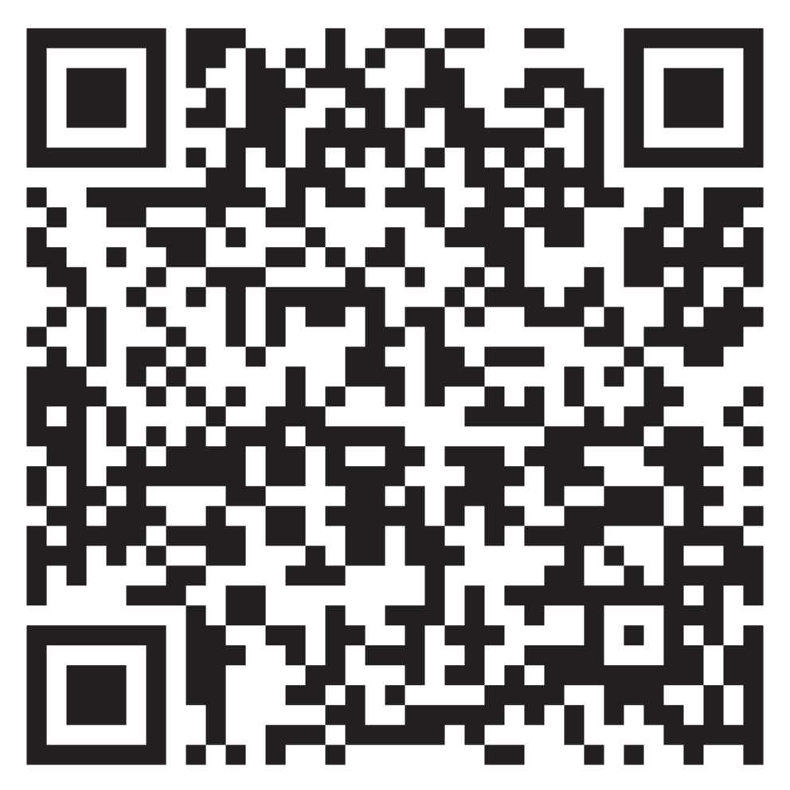

Let’s explore the School Wellbeing Check tool
Log on to: studentwellbeinghub.edu.au/educators/framework/school-wellbeing-check.
Select ‘Get started’, then ‘Take the survey’ (you may need to register to begin).
Individually, or with a partner, answer the 25 survey questions.
Submit the survey.
Notes:
Have staff individually, or in pairs, conduct the School Wellbeing Check.
The 25 questions in the Check tool are based on the Australian Student Wellbeing Framework and will provide a snapshot of your school’s wellbeing. Once participants have answered all 25 questions, have them generate their report and be ready to share what they’ve discovered. The aim of this exercise is to see what the school is doing well and to identify areas for improvement. Be prepared to acknowledge and compare where perceptions/answers may have resulted in different reports.
Note: If your group doesn’t have access to the Student Wellbeing Hub site or internet to take the survey online, please follow the steps below. Then skip to Slide 13.
Print copies (1 per participant or 1 per pair) of the sample 25-question survey (PDF) and hand them out.
Staff complete the survey questions (individually or in pairs) on the handout.
Participants share their surveys with a partner, another pair, or the whole group.
Although no digital report will be generated, discussion could take place around questions that ranked lowest or highest on the scale.
Show Slides 13 to 15 as a ‘sample’ report for discussion.

Slide 12
Survey results
What did you discover?
View your report.
Any surprises?
Greatest strengths?
Areas for improvement?
Next steps?
You might like to share your report with colleagues.

Slide 13
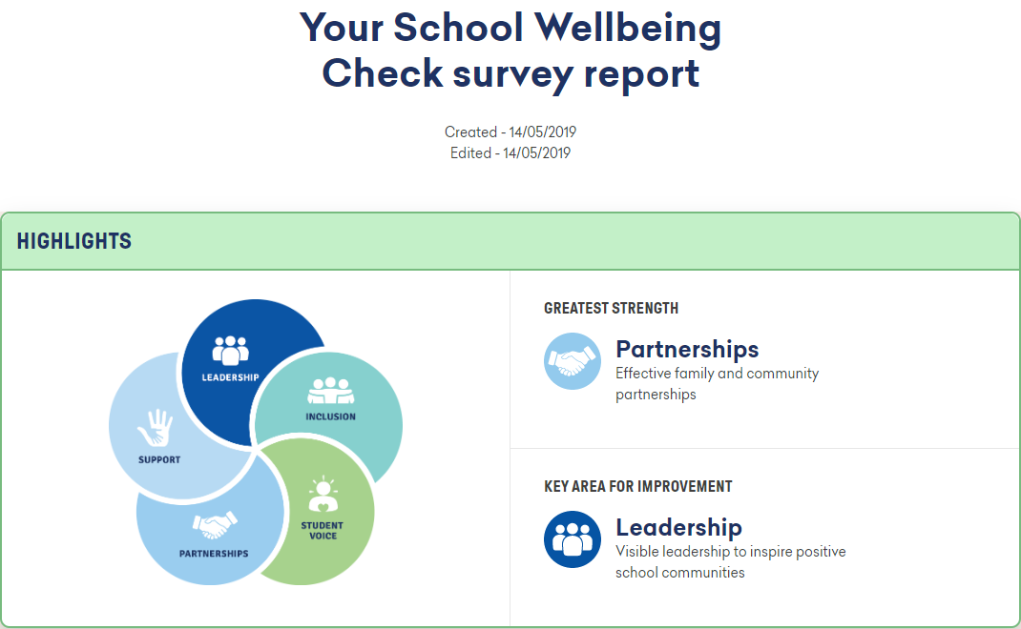
If this was your School Wellbeing Check report …
Created – 14/05/2025
Edited – 14/05/2025
Notes:
Discuss these report results as a group.
How would it feel to have ‘partnerships’ as your identified ‘greatest strength’?
How might we respond to ‘leadership’ being identified as the ‘key area for improvement’?
What practical actions could we take to improve our ‘leadership’ area?

Slide 14
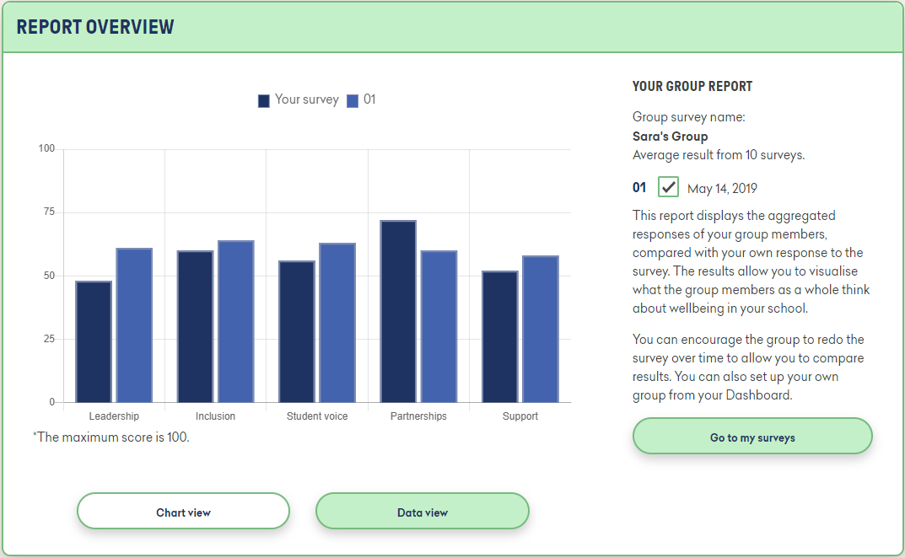
If this was your report …
May 14, 2025
Notes:
How would you interpret this graph in terms of a school’s wellbeing?

Slide 15
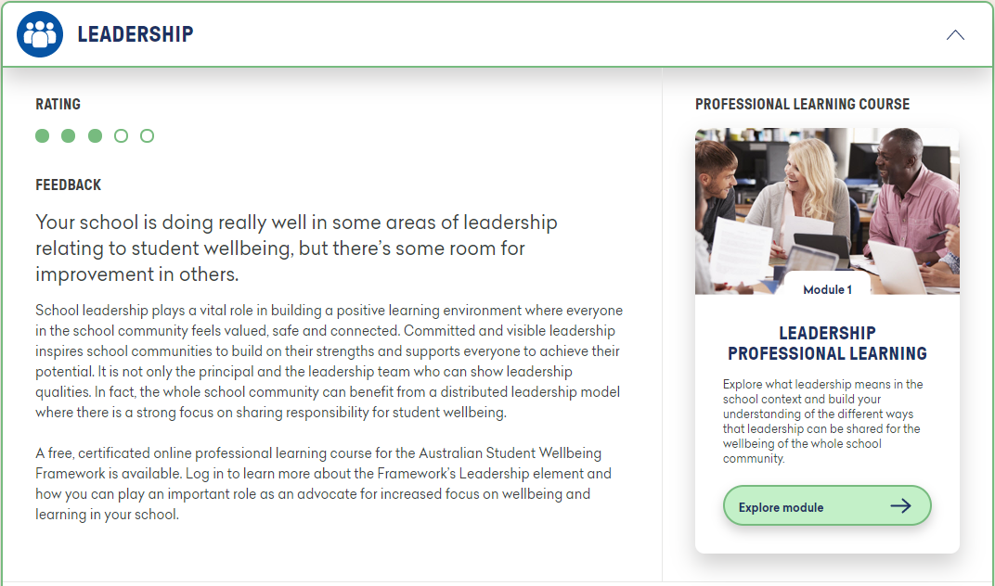
Slide 15 If this was your report…
If this was your report ……
Notes:
Discuss as a group: how useful is this part of the report?

Slide 16
Key wellbeing priorities for our school
Our top 3 actions
We will …
We will …
We will …

Slide 17
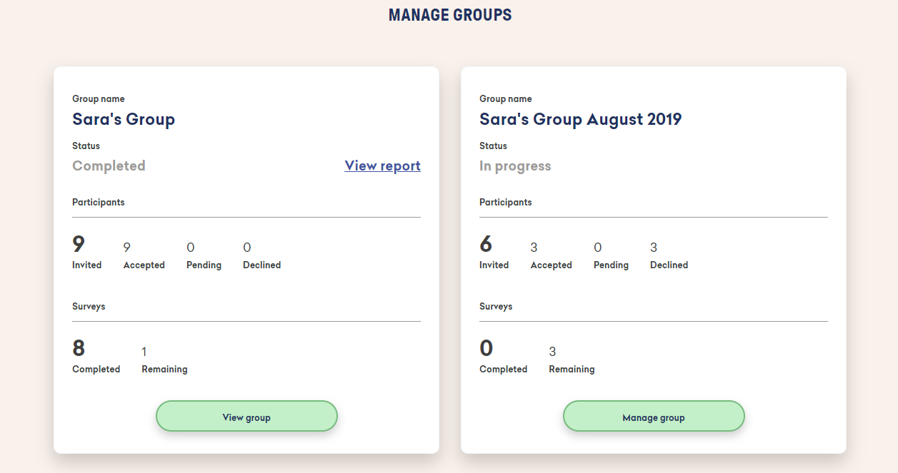
Group surveys
Sara’s Group
Sara’s Group August 2025
Notes:
For those using the School Wellbeing Check online, share with staff some of the available functions. Share with the group the ability within the tool to create a group with colleagues or faculty members to get further insight into your school’s wellbeing.

Slide 18
End of presentation
Notes:
For references, further information and related resources, visit the Student Wellbeing Hub.

